Slide 1
5. Numerical methods for calculus and differential equations.
Laura Hervert Escobar

Slide 2

Objectives
5.1 Use numerical methods to calculate integrals.
5.2 Use numerical methods to estimate derivatives.
5.3 Solve differential equations.
5.4 Use numerical methods to solve engineering problems.

Slide 3

Introduction
Assume the function f(x) is continuous on the closed interval [a,b], so the integral I(f) exists. In this chapter we develop efficient methods for computing approximations to the integral using only the values of the integrand f(x) at points $x∈[a,b]$.
The need of finding the numerical integration of functions arise because not all functions can be analytically integrated or the analytic integral my not be the most convenient way of finding the solution to a problem.

Slide 4

Skills
So far we have been working with functions and loops
Fun1 <- function (INPUT){
#Do stuff with INPUT to create OUTPUT
return (OUTPUT)}
For loops allow us to repeat a process oven and over again when we know to start and stop.
#Build a container first
for (i in start : stop){
#Do stuff over and over
#Store the result in container}

Slide 5
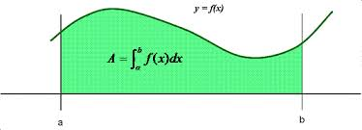
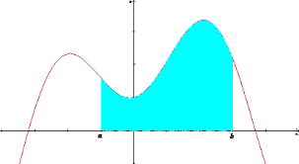
Finding Area
Finding the area under the curve is important in statistics.

Slide 6
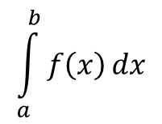

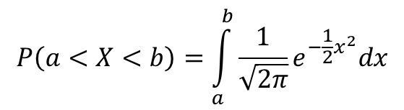
Probability
To find probability P(a < X < b) we can use Integration
Where f(x) is the probability density of X.
What if the probability density is difficult (Normal Density)?

Slide 7
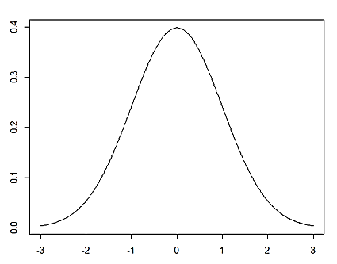
Riemann Sum
Suppose we want the área between -1 and -2

Slide 8
Riemann Sum
Add more rectangles

Slide 9
Riemann Sum
Add more rectangles

Slide 10
Riemann Sum
We are getting close

Slide 11
Riemann Sum
We are getting close

Slide 12
Riemann Sum
Let f: ℝ → ℝ defined on the closed interval [a,b] and
be a partition of [a,b] where:
a=x₀<x₁<x₂<…<x_{p}=b
with ∆x_{i}=x_{i}-x_{i-1} and x*_{i} ∈ [x_{i-1}, x_{i} ] then
is the Riemann sum

Slide 13
Riemann Sum
If we increase p so that the partition becomes finer with ∆x_{i} becoming incredibly small then:
can be used to calculate the area

Slide 14
Taylor polynomials

Slide 15
Taylor polynomials

Slide 16
Taylor polynomials

Slide 17


Steps for Taylor´s polynomial
Define X₀ (value at which it is desired to approximate the function)
Apply Taylor’s polynomial
$$\begin{matrix}T\left[f\left(x\right),x_{0}\right]=\sum_{i=0}^{\text{∞}}{\frac{f^{\left(i\right)}\left(x_{0}\right)}{i!}{\left(x−x_{0}\right)}^{i}} \\ T_{n}\left[f\left(x\right),x_{0}\right]=\sum_{i=0}^{n}{\frac{f^{\left(i\right)}\left(x_{0}\right)}{i!}{\left(x−x_{0}\right)}^{i}} \\ P_{n}\left(x\right)=\sum_{i=0}^{n}{\frac{f^{\left(i\right)}\left(x_{0}\right)}{i!}{\left(x−x_{0}\right)}^{i}} \\ P_{n}\left(x\right)=f\left(x_{0}\right)+f^{\left(1\right)}\left(x_{0}\right)\left(x−x_{0}\right)+\frac{f^{\left(2\right)}\left(x_{0}\right)}{2!}{\left(x−x_{0}\right)}^{2}+\frac{f^{\left(3\right)}\left(x_{0}\right)}{3!}{\left(x−x_{0}\right)}^{3}+...+\frac{f^{\left(n\right)}\left(x_{0}\right)}{n!}{\left(x−x_{0}\right)}^{n}\end{matrix}$$
Mac Laurin’s polynomial is a special case of Taylor’s polynomial where the X₀ = 0
$$P_{n}\left(x\right)=M_{n}\left[f\left(x\right)\right]=T_{n}\left[f\left(x\right),0\right]=f\left(0\right)+f^{\left(1\right)}\left(0\right)x+\frac{f^{\left(2\right)}\left(0\right)}{2!}x^{2}+...+\frac{f^{\left(n\right)}\left(0\right)}{n!}x^{n}$$

Slide 18
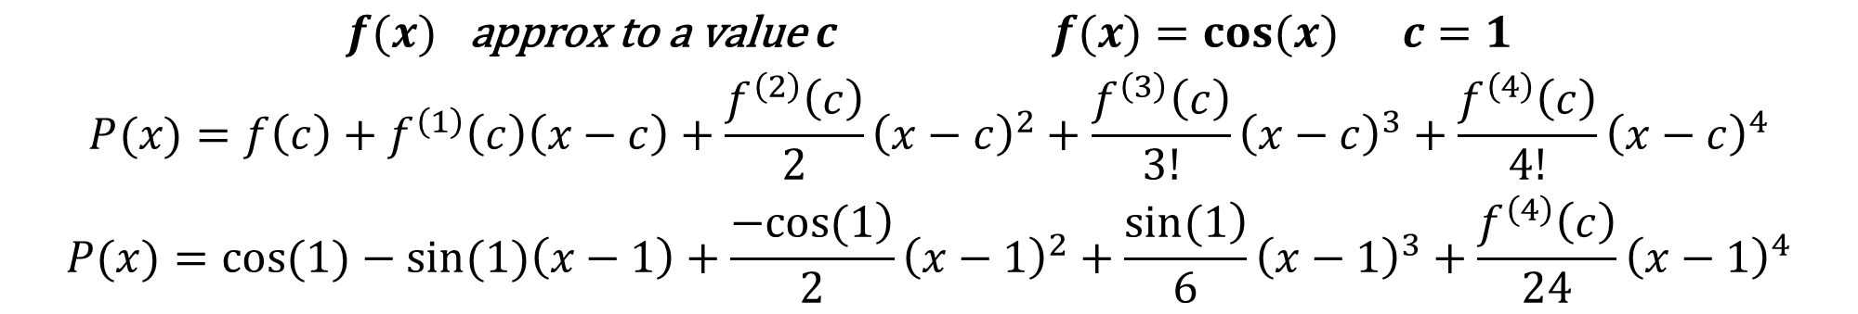
Example
FooPlot
$$\begin{matrix}f(x) \text{approx} \text{to} \text{a} \text{value} c f(x)=cos(x) c=1 \\ P(x)=f\left(c\right)+f^{\left(1\right)}\left(c\right)\left(x−c\right)+\frac{f^{\left(2\right)}\left(c\right)}{2}{\left(x−c\right)}^{2}+\frac{f^{\left(3\right)}\left(c\right)}{3!}{\left(x−c\right)}^{3}+\frac{f^{\left(4\right)}\left(c\right)}{4!}{\left(x−c\right)}^{4} \\ P(x)=cos(1)−sin(1)\left(x−1\right)+\frac{\left.−cos(1\right)}{2}{\left(x−1\right)}^{2}+\frac{\left.sin(1\right)}{6}{\left(x−1\right)}^{3}+\frac{f^{\left(4\right)}\left(c\right)}{24}{\left(x−1\right)}^{4}\end{matrix}$$

Slide 19
Montecarlo integration
?
=
4
x

Slide 20
Montecarlo integration
x²+y²=1
1
y
x²+y²≤1
x²+y²>1
x

Slide 21
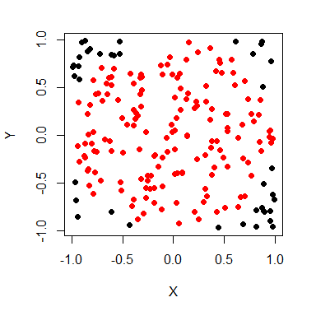
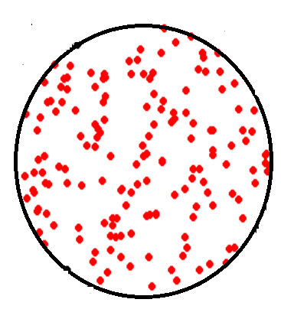
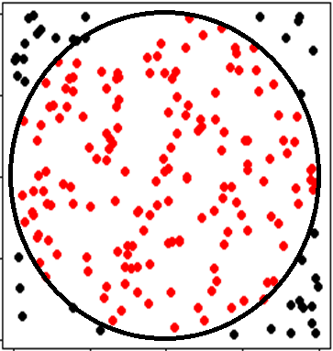
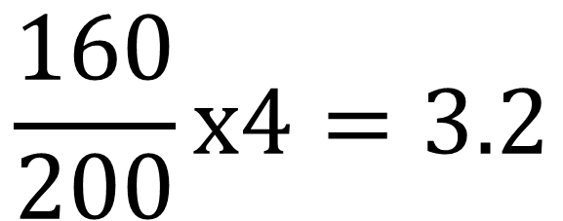
Montecarlo integration
$$\frac{160}{200}x4=3.2$$
X 4=
EJEMPLO GENERANDO 200 PUNTOS ALEATORIOS

Slide 22
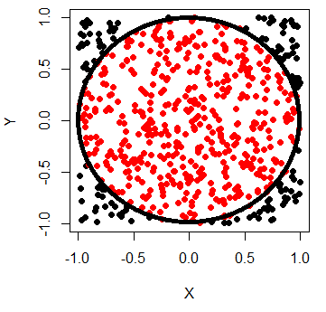
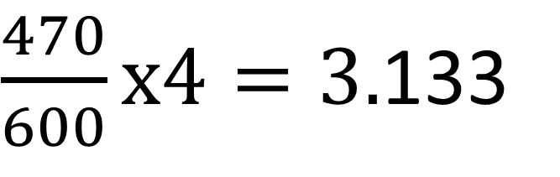
Montecarlo integration
$\frac{470}{600}x4=3.$133
EJEMPLO GENERANDO 600 PUNTOS ALEATORIOS

Slide 23
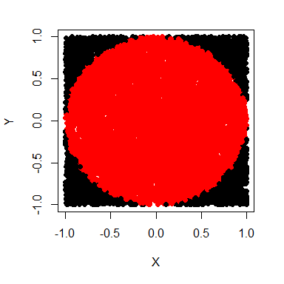
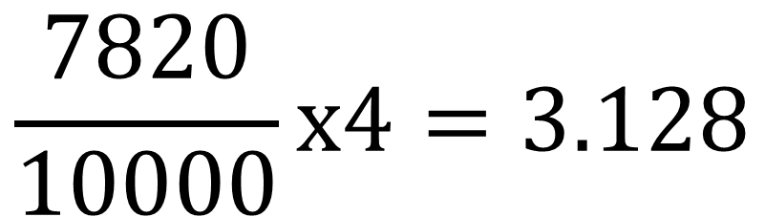
Montecarlo integration
$$\frac{7820}{10000}x4=3.128$$
EJEMPLO GENERANDO 10,000 PUNTOS ALEATORIOS

Slide 24
Numerical methods for derivatives

Slide 25
Derivatives
The derivative is the exact rate at which one quantity changes with respect to another. In calculus we have learnt that when y is the function of x , the derivative of y with respect to x i.e dy/dx measures rate of change in y with respect to x .
Geometrically , the derivatives is the slope of curve at a point on the curve . The derivative is often called as the “instantaneous” rate of change.
The derivative of a function represents an infinitely small change the function with respect to one of its variation.
The process of finding the derivatives is called as differentiation.

Slide 26
Applications
Business
Companies, both in-and-out of the financial industry have begun to use derivatives a method of speculating and generating income.
Physics
Velocity, acceleration, momentum
Chemistry
To find the concentration of an element in a product.
Biology
To model population growth, ecosystems, spread of diseases and various phenomena.

Slide 27
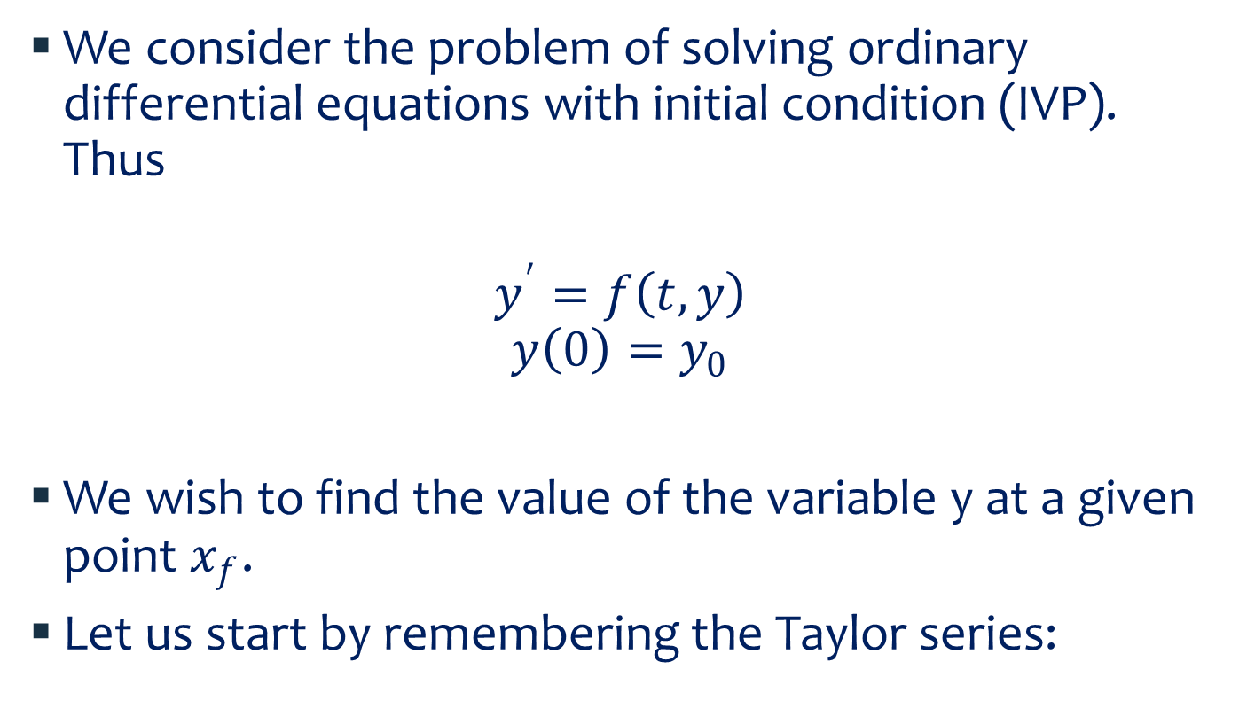
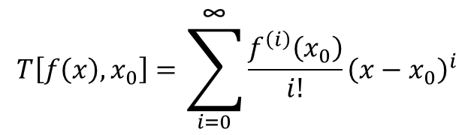
Example
We consider the problem of solving ordinary differential equations with initial condition (IVP). Thus
$$y^{′}=f\left(t,y\right)$$
$$y\left(0\right)=y_{0}$$
We wish to find the value of the variable y at a given point $x_{f}$.
Let us start by remembering the Taylor series:
In the field of differential equations, an initial value problem is an ordinary differential equation together with a specified value, called the initial condition, of the unknown function at a given point in the domain of the solution
$$T\left[f\left(x\right),x_{0}\right]=\sum_{i=0}^{\text{∞}}{\frac{f^{\left(i\right)}\left(x_{0}\right)}{i!}{\left(x−x_{0}\right)}^{i}}$$
$$y\left(t_{0}+h\right)=y\left(t_{0}\right)+hy^{′}\left(t_{0}\right)+\frac{h^{2}}{2}y^{′′}\left(t_{0}\right)+…+\frac{h^{k}}{k!}y^{\left(k\right)}\left(t_{0}\right)+O\left(h^{k+1}\right)$$

Slide 28

Euler’s method
Taking the first two terms of the series we have:
$$y\left(t_{0}+h\right)=y\left(t_{0}\right)+hy^{′}\left(t_{0}\right)$$
This method tries to approximate the value of y by using the know slope at point t0. It will of course incur in error.

Slide 29

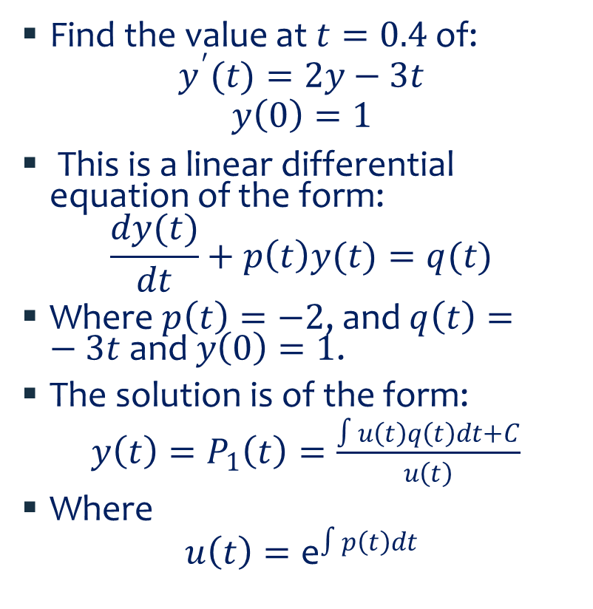
Example
In this case:
$u\left(t\right)={\text{e}}^{\int{−2}dt}={\text{e}}^{−2t}$,
So
$y\left(t\right)=\frac{∫{\text{e}}^{−2t}(−3t)dt+C}{{\text{e}}^{−2t}}$
Find the value at $t=0.4$ of:
$$y^{′}(t)=2y−3t$$
$$y\left(0\right)=1$$
This is a linear differential equation of the form:
$$\frac{dy(t)}{dt}+p\left(t\right)y(t)=q(t)$$
Where $p\left(t\right)=−2$, and $q\left(t\right)=−3t$ and $y\left(0\right)=1$.
The solution is of the form:
$y\left(t\right)=P_{1}\left(t\right)=\frac{∫u\left(t\right)q\left(t\right)dt+C}{u\left(t\right)}$
Where
$$u\left(t\right)={\text{e}}^{∫p\left(t\right)dt}$$

Slide 30
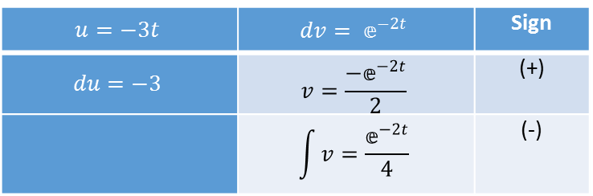




Example….
$$u=−3t$$ | $$dv= 𝕖^{−2t}$$ | Sign
$$du=−3$$ | $$v=\frac{{−𝕖}^{−2t}}{2}$$ | (+)
 | $$\int{v}=\frac{𝕖^{−2t}}{4}$$ | (-)
Integrating by parts $−3t{\text{e}}^{−2t}$ we find:
$$\int_{0}^{t}{−3te^{−2t}dx=}{\left[−3t\frac{{−𝕖}^{−2t}}{2}−3\frac{−𝕖^{−2t}}{4}\right]}_{0}^{t}=\frac{3t}{2}𝕖^{−2t}+3\frac{3}{4}𝕖^{−2t}−\frac{3}{4}$$
$$y\left(t\right)=\frac{∫{\text{e}}^{−2t}(−3t)dt+C}{{\text{e}}^{−2t}}=e^{2t}\left(\frac{3}{2}te^{−2t}+\frac{3}{4}e^{−2t}−\frac{3}{4}+C\right)$$
For $y\left(0\right)=1$, we get $C=1$. Therefore:
$$y\left(t\right)=\frac{3}{2}t+\frac{3}{4}+\frac{1}{4}e^{2t}$$
And thus
$$y\left(0.4\right)=1.906385232$$

Slide 31
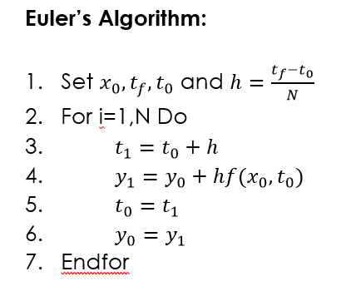
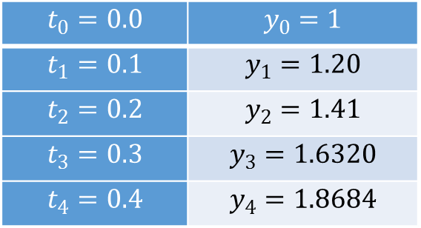
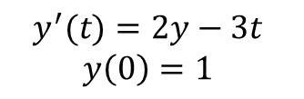



Example
Applying Euler’s method we find with $h=0.1$:
So we find a close approximation with in 2% of error. Where as, with $h=0.1$ and N=40, we get $y_{40}=1.90201$ a much smaller error
$$t_{0}=0.0$$ | $$y_{0}=1$$
$$t_{1}=0.1$$ | $$y_{1}=1.20$$
$$t_{2}=0.2$$ | $$y_{2}=1.41$$
$$t_{3}=0.3$$ | $$y_{3}=1.6320$$
$$t_{4}=0.4$$ | $$y_{4}=1.8684$$
$$y^{′}(t)=2y−3t$$
$$y\left(0\right)=1$$
$$y\left(t_{0}+h\right)=y\left(t_{0}\right)+hy^{′}\left(t_{0}\right)$$
$$y\left(0.4\right)=1.906385232$$

Slide 32
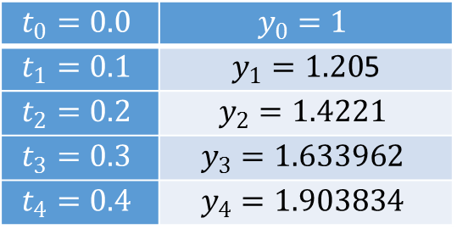
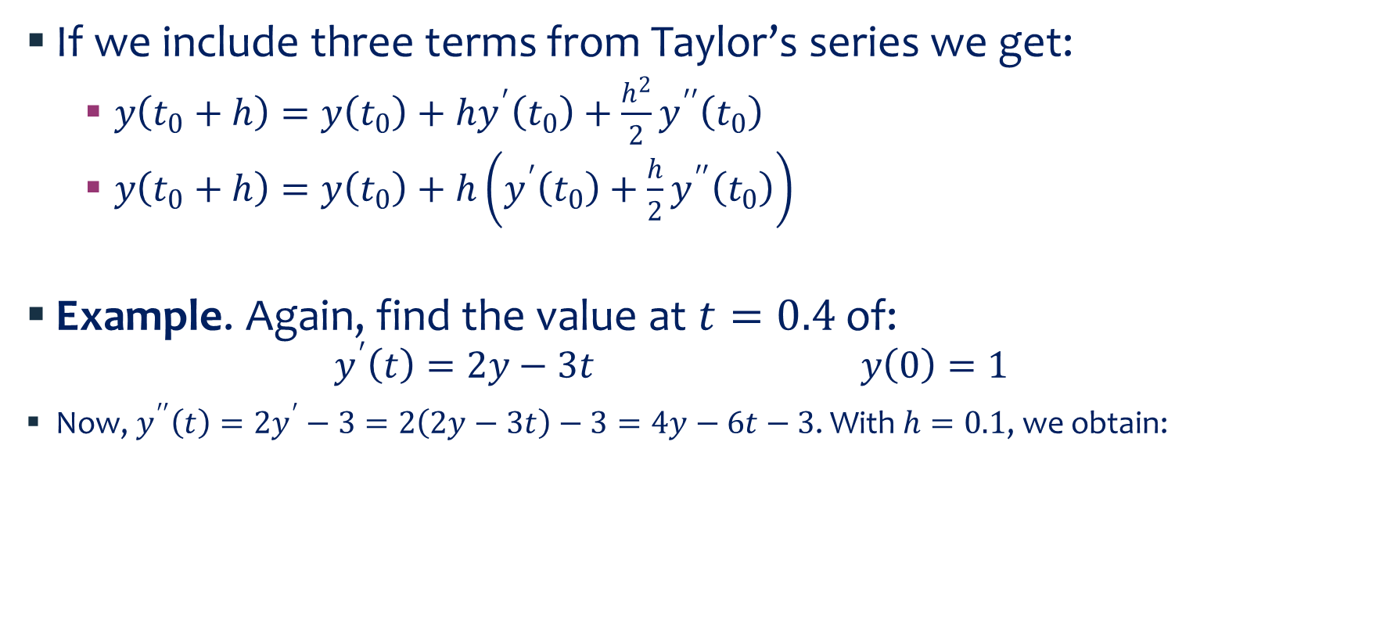
Second order Euler
If we include three terms from Taylor’s series we get:
$y\left(t_{0}+h\right)=y\left(t_{0}\right)+hy^{′}\left(t_{0}\right)+\frac{h^{2}}{2}y^{′′}\left(t_{0}\right)$
$y\left(t_{0}+h\right)=y\left(t_{0}\right)+h\left(y^{′}\left(t_{0}\right)+\frac{h}{2}y^{′′}\left(t_{0}\right)\right)$
Example. Again, find the value at $t=0.4$ of:
$$y^{′}\left(t\right)=2y−3t y\left(0\right)=1$$
Now, $y^{′′}\left(t\right)=2y^{′}−3=2\left(2y−3t\right)−3=4y−6t−3$. With $h=0.1$, we obtain:
$$t_{0}=0.0$$ | $$y_{0}=1$$
$$t_{1}=0.1$$ | $y_{1}=1.20$5
$$t_{2}=0.2$$ | $$y_{2}=1.4221$$
$$t_{3}=0.3$$ | $$y_{3}=1.633962$$
$$t_{4}=0.4$$ | $$y_{4}=1.903834$$

Slide 33
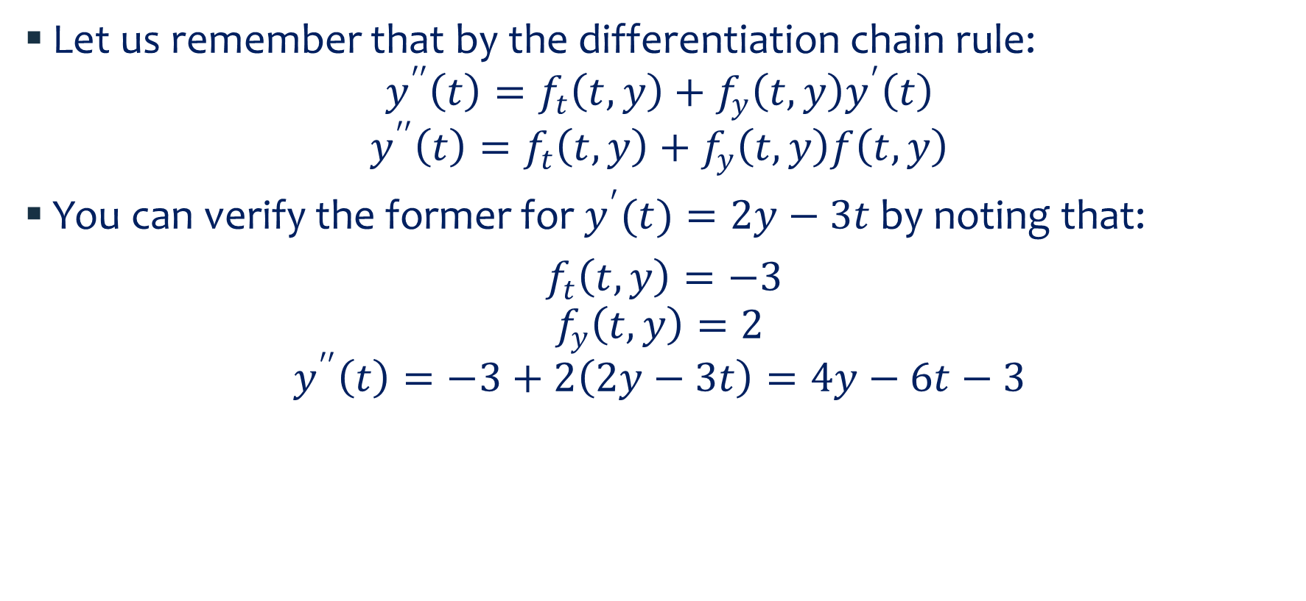
Heun’s Method
Let us remember that by the differentiation chain rule:
$$y^{′′}\left(t\right)=f_{t}\left(t,y\right)+f_{y}\left(t,y\right)y^{′}\left(t\right)$$
$$y^{′′}\left(t\right)=f_{t}\left(t,y\right)+f_{y}\left(t,y\right)f\left(t,y\right)$$
You can verify the former for $y^{′}(t)=2y−3t$ by noting that:
$f_{t}\left(t,y\right)=−3$
$$f_{y}\left(t,y\right)=2$$
$$y^{′′}\left(t\right)=−3+2\left(2y−3t\right)=4y−6t−3$$

Slide 34
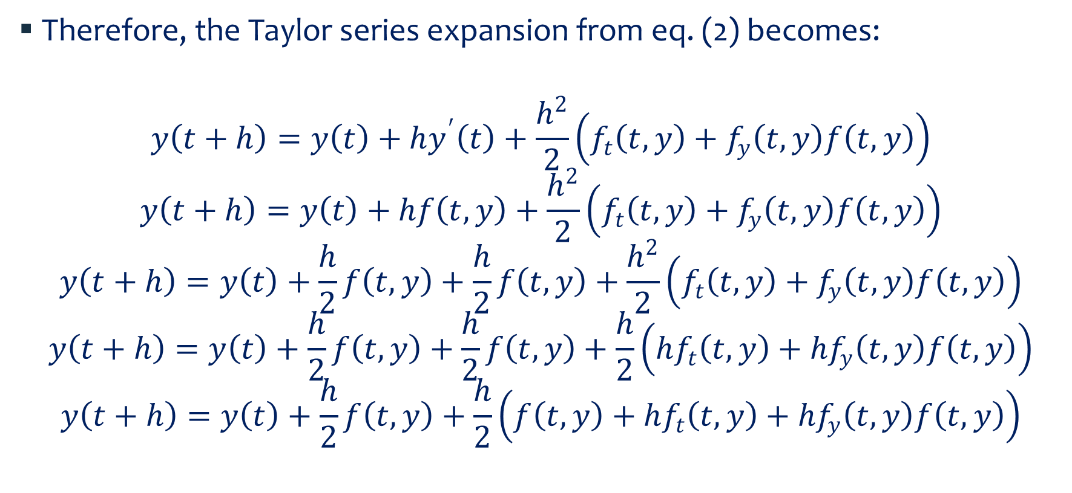
Heun’s Method…
Therefore, the Taylor series expansion from eq. (2) becomes:
$$y\left(t+h\right)=y\left(t\right)+hy^{′}\left(t\right)+\frac{h^{2}}{2}\left(f_{t}\left(t,y\right)+f_{y}\left(t,y\right)f\left(t,y\right)\right)$$
$$y\left(t+h\right)=y\left(t\right)+hf\left(t,y\right)+\frac{h^{2}}{2}\left(f_{t}\left(t,y\right)+f_{y}\left(t,y\right)f\left(t,y\right)\right)$$
$$y\left(t+h\right)=y\left(t\right)+\frac{h}{2}f\left(t,y\right)+\frac{h}{2}f\left(t,y\right)+\frac{h^{2}}{2}\left(f_{t}\left(t,y\right)+f_{y}\left(t,y\right)f\left(t,y\right)\right)$$
$$y\left(t+h\right)=y\left(t\right)+\frac{h}{2}f\left(t,y\right)+\frac{h}{2}f\left(t,y\right)+\frac{h}{2}\left(hf_{t}\left(t,y\right)+{hf}_{y}\left(t,y\right)f\left(t,y\right)\right)$$
$$y\left(t+h\right)=y\left(t\right)+\frac{h}{2}f\left(t,y\right)+\frac{h}{2}\left(f\left(t,y\right)+hf_{t}\left(t,y\right)+{hf}_{y}\left(t,y\right)f\left(t,y\right)\right)$$

Slide 35
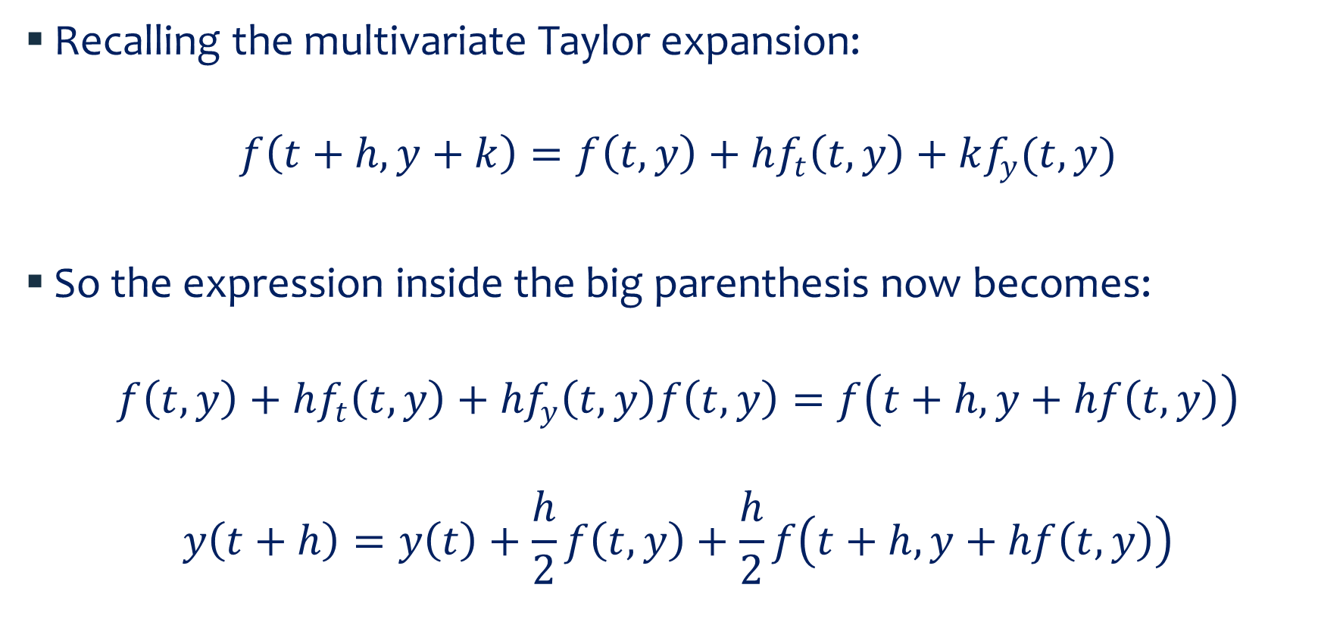
Heun’s Method…
Recalling the multivariate Taylor expansion:
$$f\left(t+h,y+k\right)=f\left(t,y\right)+hf_{t}\left(t,y\right)+kf_{y}(t,y)$$
So the expression inside the big parenthesis now becomes:
$$f\left(t,y\right)+hf_{t}\left(t,y\right)+{hf}_{y}\left(t,y\right)f\left(t,y\right)=f\left(t+h,y+hf\left(t,y\right)\right)$$
$$y\left(t+h\right)=y\left(t\right)+\frac{h}{2}f\left(t,y\right)+\frac{h}{2}f\left(t+h,y+hf\left(t,y\right)\right)$$

Slide 36
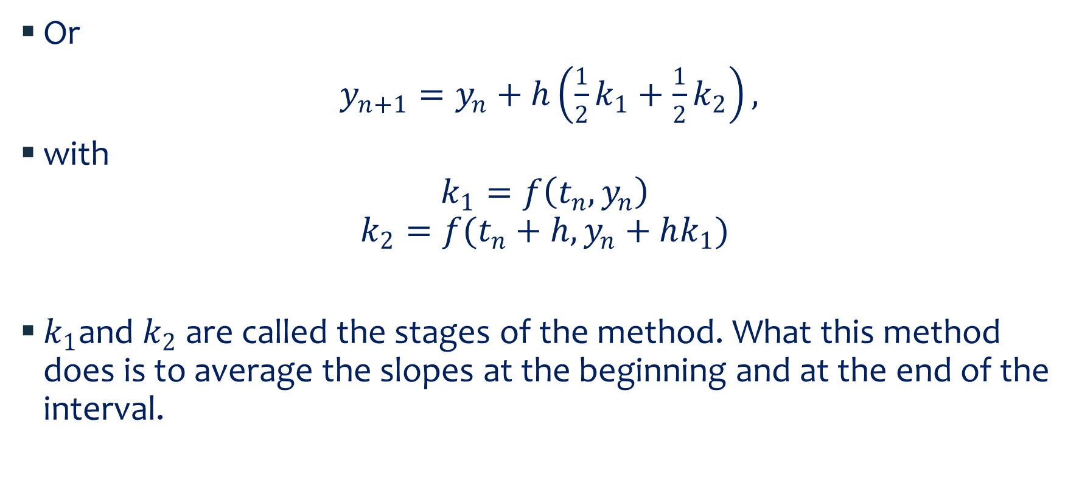
Heun’s Method…
Or
$y_{n+1}=y_{n}+h\left(\frac{1}{2}k_{1}+\frac{1}{2}k_{2}\right),$
with
$$k_{1}=f\left(t_{n},y_{n}\right)$$
$$k_{2}=f(t_{n}+h,y_{n}+hk_{1})$$
$k_{1}$and $k_{2}$ are called the stages of the method. What this method does is to average the slopes at the beginning and at the end of the interval.

Slide 37
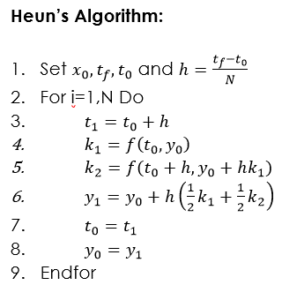
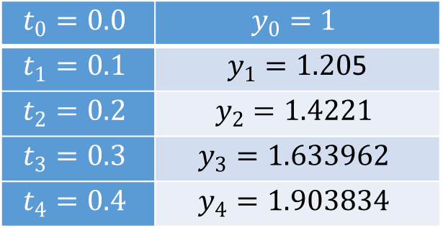
Example
From previous case:
Which is the exact same result as the previous example without having to explicitly do the second derivative.
$$t_{0}=0.0$$ | $$y_{0}=1$$
$$t_{1}=0.1$$ | $y_{1}=1.20$5
$$t_{2}=0.2$$ | $$y_{2}=1.4221$$
$$t_{3}=0.3$$ | $$y_{3}=1.633962$$
$$t_{4}=0.4$$ | $$y_{4}=1.903834$$

Slide 38

Mid Step Algorithm
Another alternative to get a better estimation of the true slop is to take a trial step into the middle of the interval and use that slope as shown in the next figure:
Thus
$$k_{1}=f\left(t_{n},y_{n}\right)$$
$$k_{2}=f(t_{n}+\frac{h}{2},y_{n}+\frac{h}{2}k_{1})$$
$$y_{n+1}=y_{n}+hk_{2},$$

Slide 39
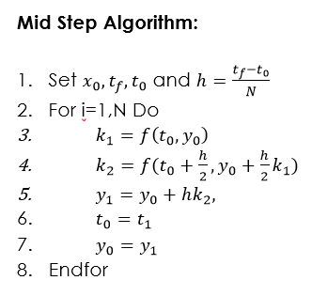
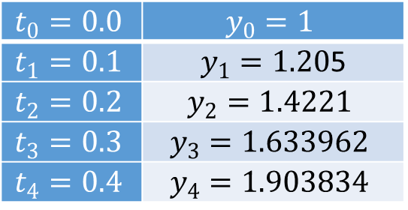
Example
From previous example
Which is the exact same result as the previous example
$$t_{0}=0.0$$ | $$y_{0}=1$$
$$t_{1}=0.1$$ | $y_{1}=1.20$5
$$t_{2}=0.2$$ | $$y_{2}=1.4221$$
$$t_{3}=0.3$$ | $$y_{3}=1.633962$$
$$t_{4}=0.4$$ | $$y_{4}=1.903834$$

